Slide 1
Cascading STYLE Sheet

Slide 2
CSS
Html
Used for marking up information to be rendered in a browser.
CSS- Cascading Style Sheet
1. Specifies the presentation of elements on a web page (e.g., fonts, spacing, sizes, colors, positioning) separately from the document’s structure and content
2. CSS can be added to HTML documents in 3 ways
a) Inline b)Embedded or internal c) External

Slide 3
Introduction
CSS stands for Cascading Style Sheets
Style sheet language used to describe the presentation of
a document written in HTML or XML
how HTML elements are to be displayed on screen, paper,
or in other media
Colors, fonts, alignment, borders, backgrounds, spacing, margins, etc…
It can control the layout of multiple web pages all at once
Advantage
Reusability
Separate the content and presentation

Slide 4
CSS vs. just HTML
What can we do with CSS that we can’t do with HTML?
Control of backgrounds.
Set font size to the exact height you want.
Highlight words, entire paragraphs, headings or even individual letters with background colors.
Overlap words and make logo-type headers without making images.
Precise positioning.
Linked style sheets to control the look of a whole website from one single location.

Slide 5
HTML & CSS Code
To set red color as the background color of a webpage
HTML
<body bgcolor="#FF0000">
CSS
body {background-color: #FF0000;}

Slide 6
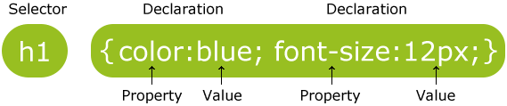
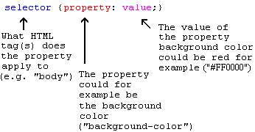
How to write CSS?
CSS rule-set consists of a selector and a declaration block
Selector
HTML element tags (examples: p, h2, body, img, table)
class and ID names
Property (examples: color, font-size)
Value (examples: red, 14pt)

Slide 7
Basic Structure of a Style
Each definition contains:
A property
A colon
A value
A semicolon to separate two or more values
Can include one or more values
h1 {font-size:12pt; color:red}

Slide 8
Example:
p {
color: red;
text-align: center;
}
body { background-color: lightblue; }

Slide 9
Type of CSS
Inline - by using the style attribute inside HTML elements
Internal - by using a <style> element in the <head> section
External - by using a <link> element to link to an external CSS file
The most common way of using CSS is using external style sheet.

Slide 10
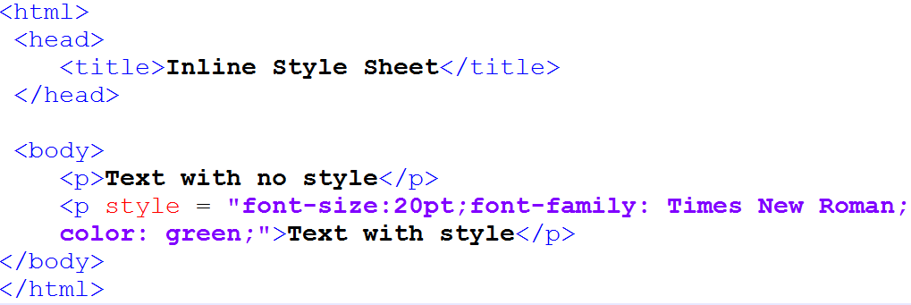

Inline Style sheet
Used to apply a unique style to a single HTML element

Slide 11
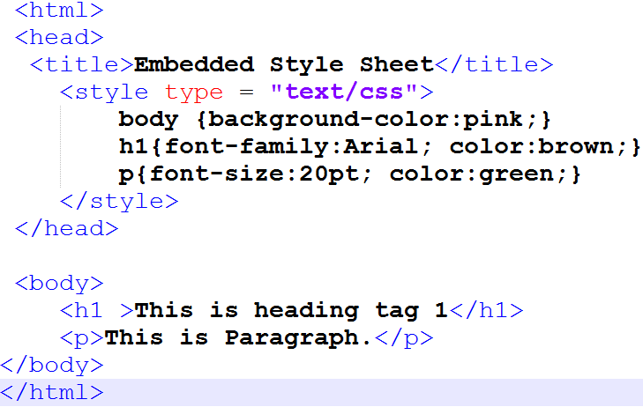
Embedded/ Internal Style sheet
Used to define a style for a single HTML page
Defined in the <head> section of an HTML page, within a <style> element.

Slide 12

Embedded/ Internal Style sheet

Slide 13
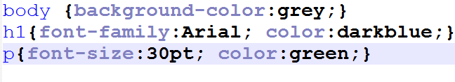
External Style Sheet
Used to define the style for entire website
The style sheet is written in separate file stored with .css extension
To use an external style sheet, add a link to it in the <head> section of each HTML page
Style.css

Slide 14
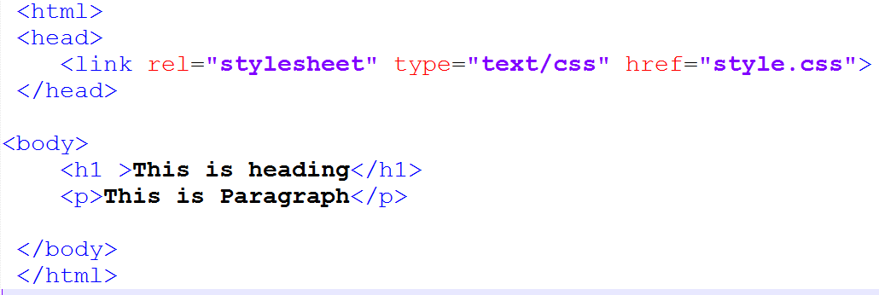
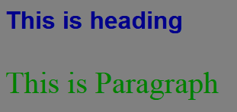
External Style Sheet
External.html

Slide 15
External Style Sheet
<link> rel Attribute
Specifies the relationship between the current document and the linked document
<link rel =“style sheet”>
Refers the imported document is CSS style sheet
<link> type Attribute
Specifies the Internet media type of <style> tag
It identifies the content between the <style> and </style> tags.
The default value is "text/css", which indicates that the content is CSS.

Slide 16
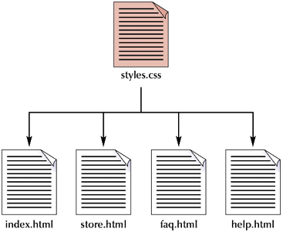
Applying a single style sheet to multiple documents

Slide 17
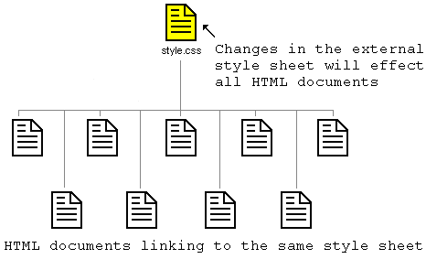
Advantages of External Style Sheet
Saves Time
can change the look of an entire website by changing just one file

Slide 18
CSS Inheritance: - which style prevails when several are present?
Inline (local) overrides internal & external styles
Internal style sheet overrides external styles

Slide 19
CSS Selectors
CSS selectors are used to "find" (or select) HTML elements based on their element name, id, class, attribute, and more
Types
Simple selectors (select elements based on name, id, class)
Element name selector
Element id selector
Element class selector
Universal selector
Grouping Selectors
Pseudo-class selectors (select elements based on a certain state)
:hover

Slide 20
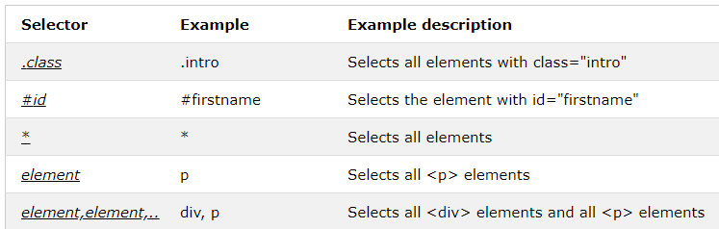
CSS Simple Selectors

Slide 21
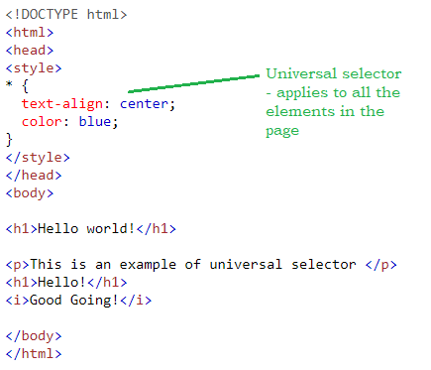
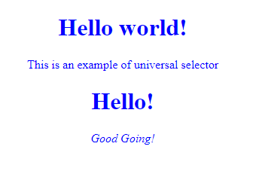
CSS Universal Selector - Example

Slide 22
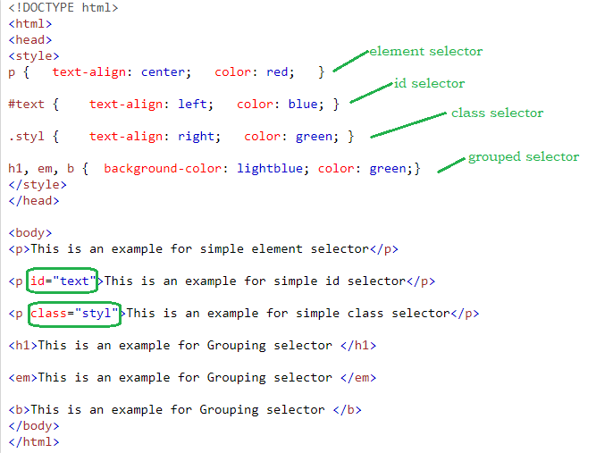
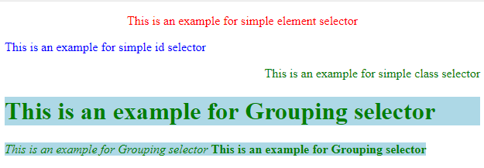
CSS Selectors - Example

Slide 23
Text properties
Color
The color property is used to set the color of a text. The color is specified by:
a color name - "red"
a HEX value - "#ff0000"
an RGB value - "rgb(255,0,0)“
text-align :Specifies the horizontal alignment of text
text-align : left|center|right|justify
Example: h1 {
text-align: center;
}
Example:
h1 { color: green; }

Slide 24
Text properties
text-transform:
This property controls the capitalization of text Specifies the kind of text decoration to be used (underline, overline, etc.)
text-transform: capitalize|uppercase|lowercase
Example: h2 { text-transform: lowercase;
}
font
font-family:
.p1 {
font-family: "Times New Roman”;
font-size: 30px;
}

Slide 25
Backgrounds
background-color:applies background color
Example: background-color: lightblue;
background-image: set the background image
background-image: “images/css.jpg”
background-postion:Sets the starting position of a background image
Value:
left top |left center|left bottom|right top
(xpos ypos)
background-position: 10% 40%;
background-position: 10px 40px;

Slide 26
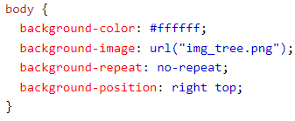

Background-shorthand Property
It does not matter if one of the property values is
missing, as long as the other ones are in this order
or

Slide 27
<Div> & <Span> tag
HTML Block (DIV) and Inline (SPAN) Elements
<DIV>
defines a division or a section in an HTML document
used as a container for HTML elements - which is then styled with CSS or manipulated with JavaScript
easily styled by using the class or id attribute
<Span>
an inline container used to mark up a part of a text, or a part of a document
easily styled by CSS or manipulated with JavaScript using the class or id attribute
much like the <div> element, but <div> is a block-level element and <span> is an inline element.

Slide 28
HTML Block and Inline Elements
Block Elements
Inline Elements
<address>
<blockquote>
<div>
<fieldset>
<figcaption>
<figure>
<footer>
<form>
<h1>-<h6>
<header>
<hr>
<li>
<nav>
<ol>
<p>
<pre>
<section>
<table>
<tfoot>
<ul>
<video>
<a>
<abbr>
<acronym>
<b>
<bdo>
<br>
<button>
<cite>
<code>
<dfn>
<em>
<i>
<img>
<sub>
<sup>
<input>
<kbd>
<label>
<map>
<object>
<output>
<q>
<script>
<select>
<small>
<span>
<strong>
<textarea>
<time>

Slide 29
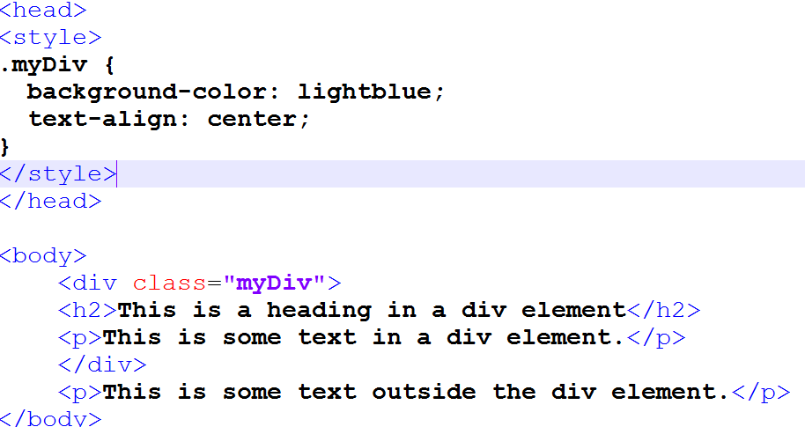
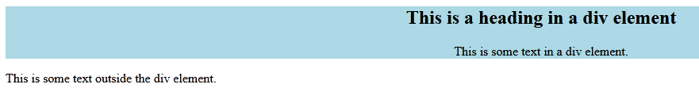
HTML <div> Tag

Slide 30
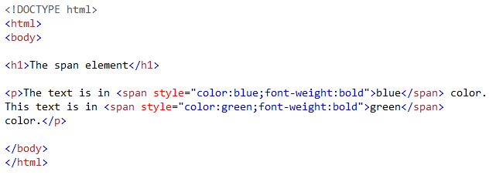
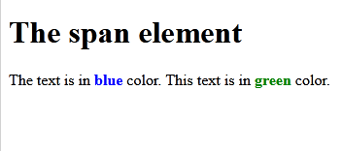
HTML <span> Tag

Slide 31
CSS Box Model
All HTML elements can be considered as boxes
CSS box model is essentially a box that wraps around every HTML element.
It consists of
Content - The content of the box, where text and images appear
Padding - Clears an area around the content. The padding is transparent
Border - A border that goes around the padding and content
Margin - Clears an area outside the border. The margin is transparent

Slide 32
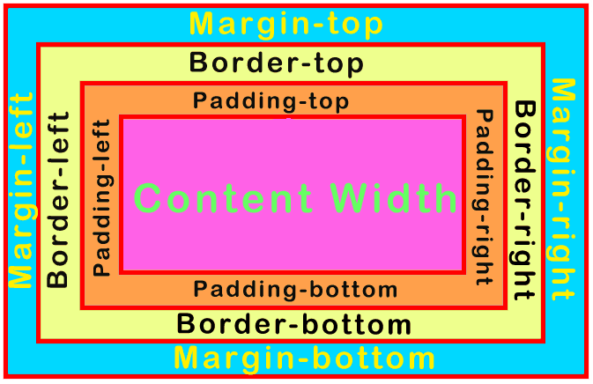
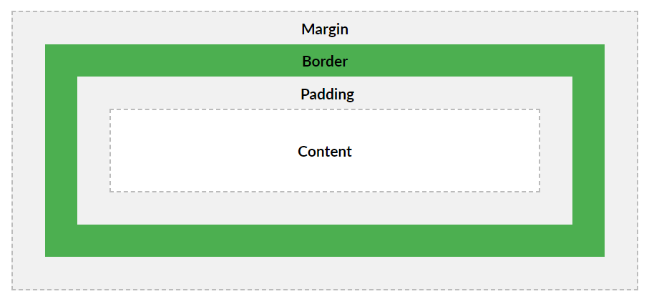
BOX MODEL

Slide 33
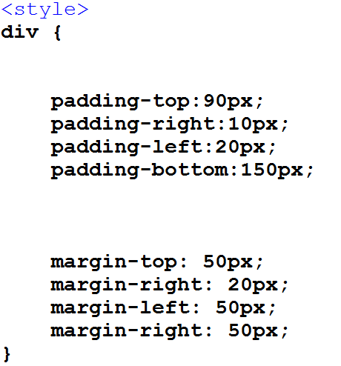
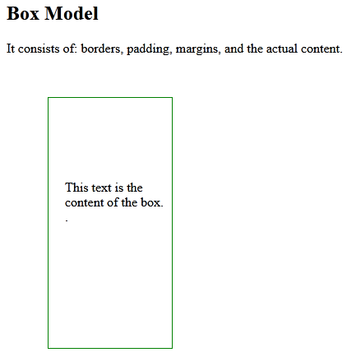
BOX- Margin and Padding

Slide 34
MARGIN PROPERTY
CSS margin properties are used to create space around elements, outside of any defined borders.
margin:10px margin-top:5px margin-right:10px margin-bottom:10px margin-left:10px

Slide 35
PADDING PROPERTY
Padding properties are used to generate space around contents
Shorthand property padding: 2px ; padding-left::2px ; padding-right:2px ; padding-bottom:2px; padding-top:2px ;

Slide 36
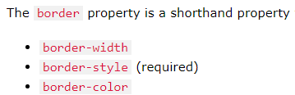
BORDER PROPERTY
Shorthand property border: 2px solid pink border-left::2px solid pink border-right:2px solid pink border-bottom:2px solid pink border-top:2px solid pink |  | border-width:2px border-style:solid border-color:pink
border-left border-left-width border-left-color border-left-style | border-right border-right-width border-right-color border-right-style | border-bottom: border-bottom-width border-bottom-color border-bottom-style | border-top border-top-width border-top-color border-top-style

Slide 37
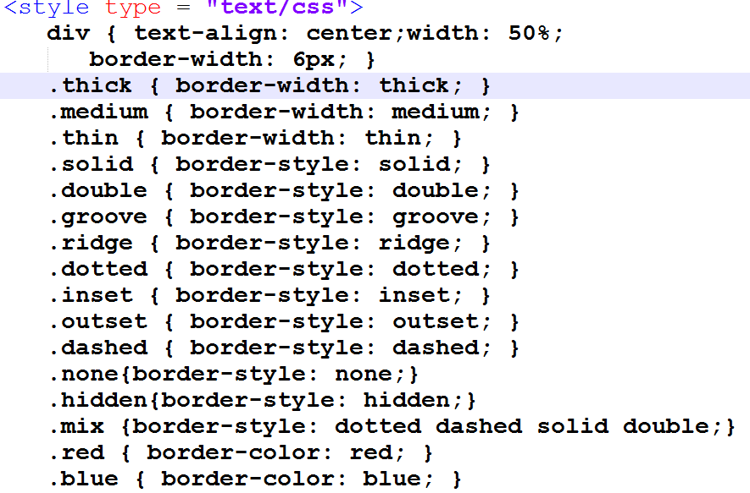
CSS Border Style

Slide 38
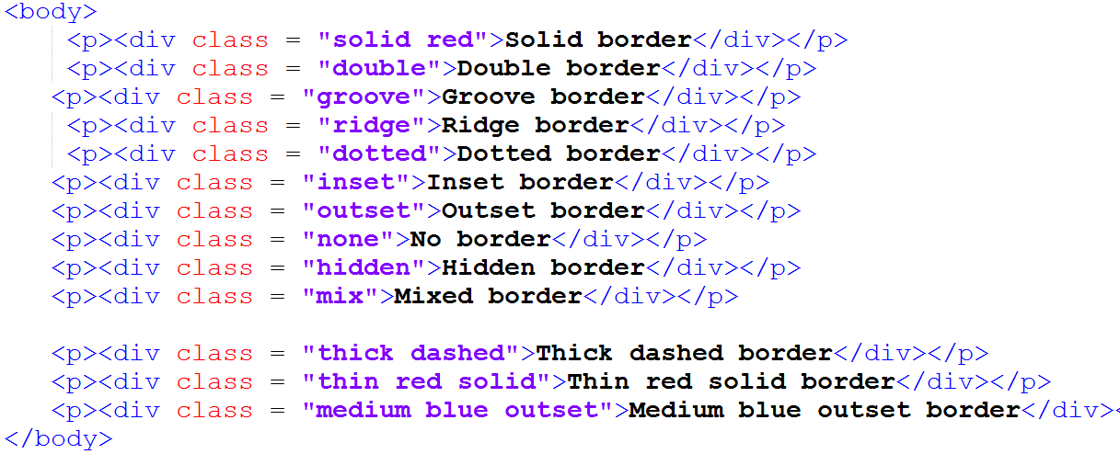
CSS Border Style
Combined class of solid and red

Slide 39
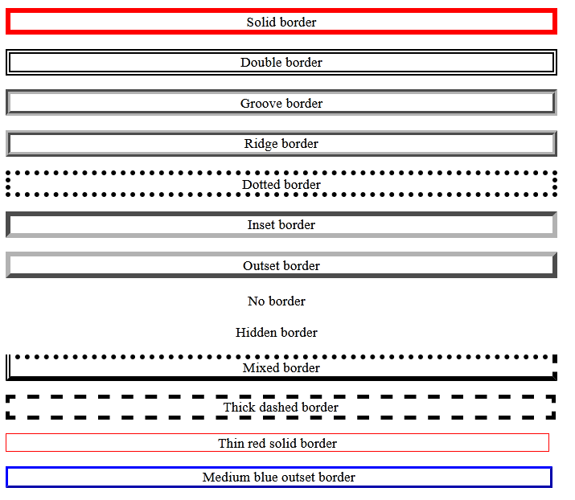
CSS Border Style

Slide 40
Height and width property
The height and width properties are used to set the height and width of an element.
It sets the height/width of the area inside the padding, border, and margin of the element.
Value can be
Length-Defines the height/width in px, cm, etc.
% - Defines the height/width in percent of the containing block

Slide 41
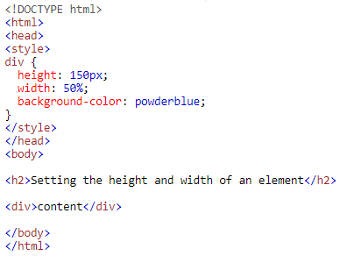
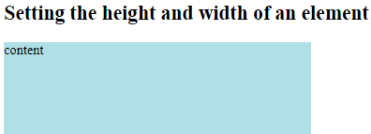
Example

Slide 42
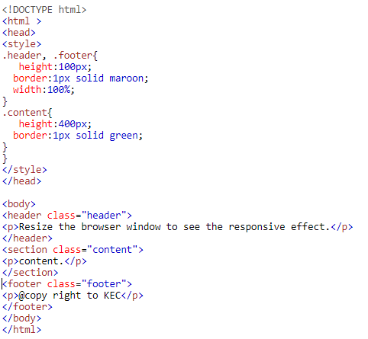
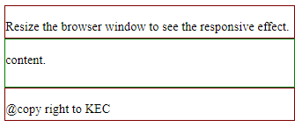

Slide 43
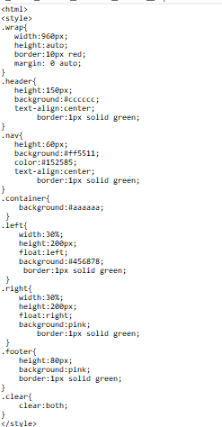
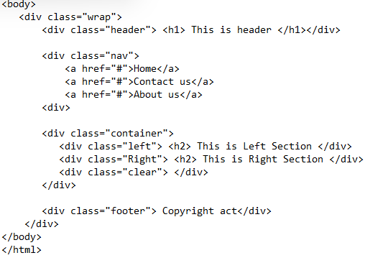
Additional example-

Slide 44
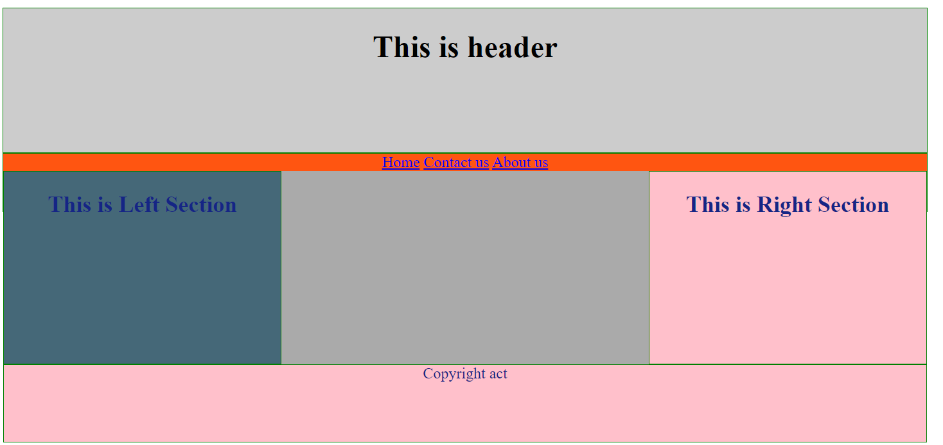
Output

